Slide 1
College ID Recruiting Webinar
Presented By: Sue Webber & Luis Cortell

Slide 2
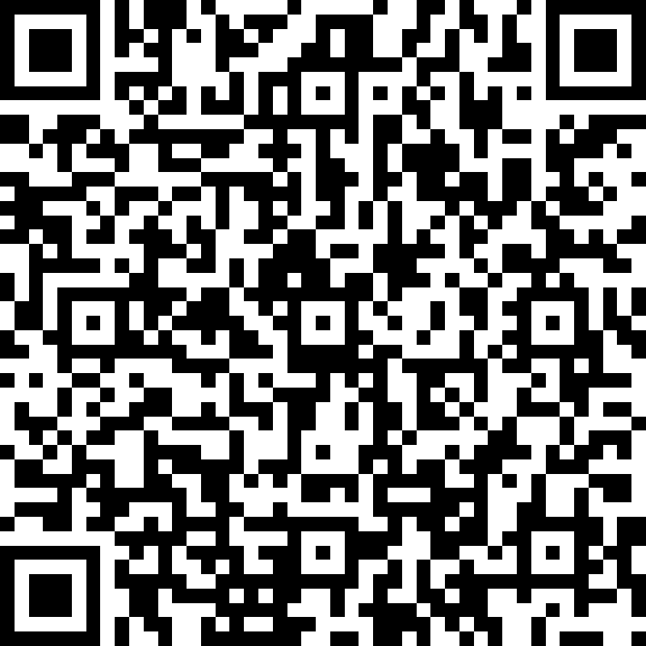
Before WE BEGIN
Be Ready to TAKE NOTES
Type Questions in the Q&A Section
Help Us Get to KNOW YOU!
In the CHAT BOX:
First Name
Grad Year
City / State
Position(s)
TO SCHEDULE YOUR FREE NCSA RECRUITING CALL
SCAN HERE:

Slide 3
WELCOME
Sue Webber - Event Partnership Director
Played Volleyball at the University of Illinois
Coached at NCAA Division I and NAIA Programs
Club Recruiting Coordinator & Coach for 10 years
6 years at NCSA
Luis Cortell – Senior Soccer Recruiting Coach
Played Soccer at the University of Findlay
Coached at NAIA and NCAA Division II Programs (2X National Champion)
Athletic Director, Club Director and Coach for 8 years
2.5 years at NCSA

Slide 4
GAME PLAN
Who is NCSA?
Recruiting Calendars, Scholarships & Checklists
Recruiting Tips for College ID Combine
NCSA College Recruiting Resources
Next Steps and Q&A

Slide 5
WHO IS NCSA?
Founded in 2000, we are now the largest and most successful college athletic recruiting network with 800+ employees, many former college coaches & players
NCSA has helped more than 250,000 NCSA student-athletes find their right college fit
Last year, 25,000 students committed to playing in college through NCSA
We work with athletes and coaches in 37 men’s & women’s sports

Slide 6
Recruiting Calendars, Scholarships & Checklists

Slide 7
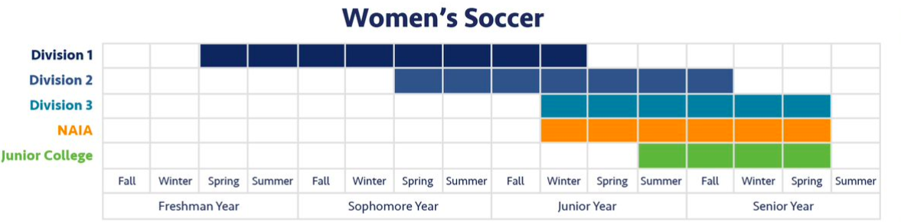
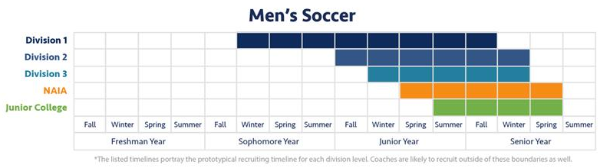
RECRUITING TIMELINES
Reminder!!! These are general recruiting timelines but could be different for individual programs.

Slide 8
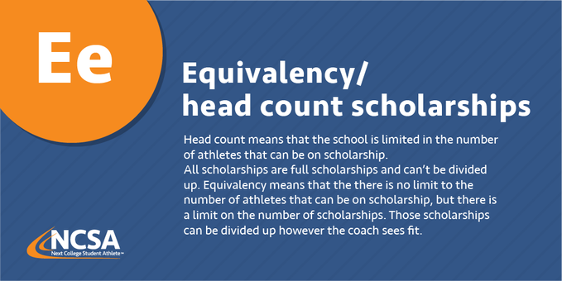
Scholarship TERMS

Slide 9
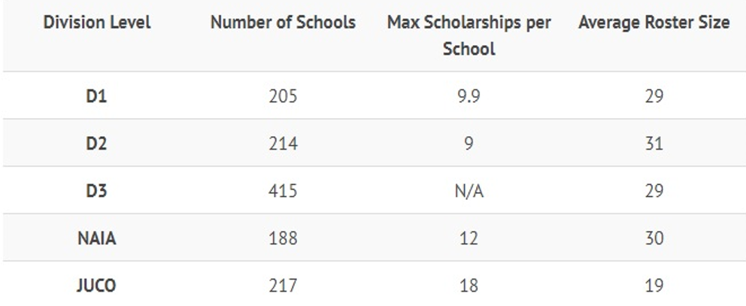
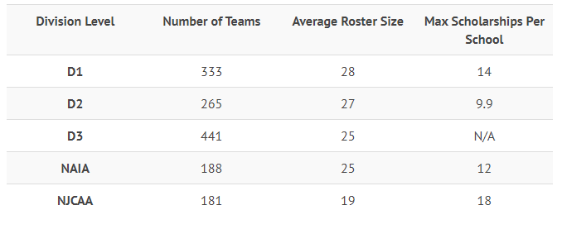
SCHOLARSHIP OPPORTUNITIES
MENS
WOMENS
https://www.ncsasports.org/mens-soccer/scholarships
https://www.ncsasports.org/womens-soccer/scholarships

Slide 10
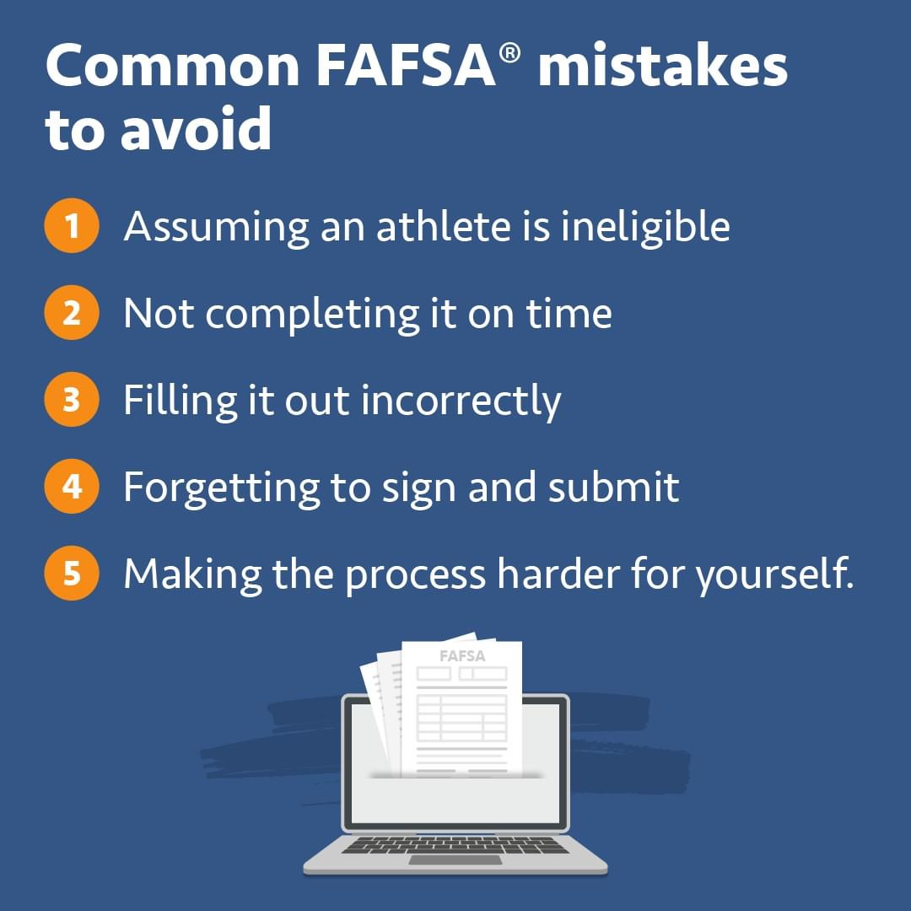
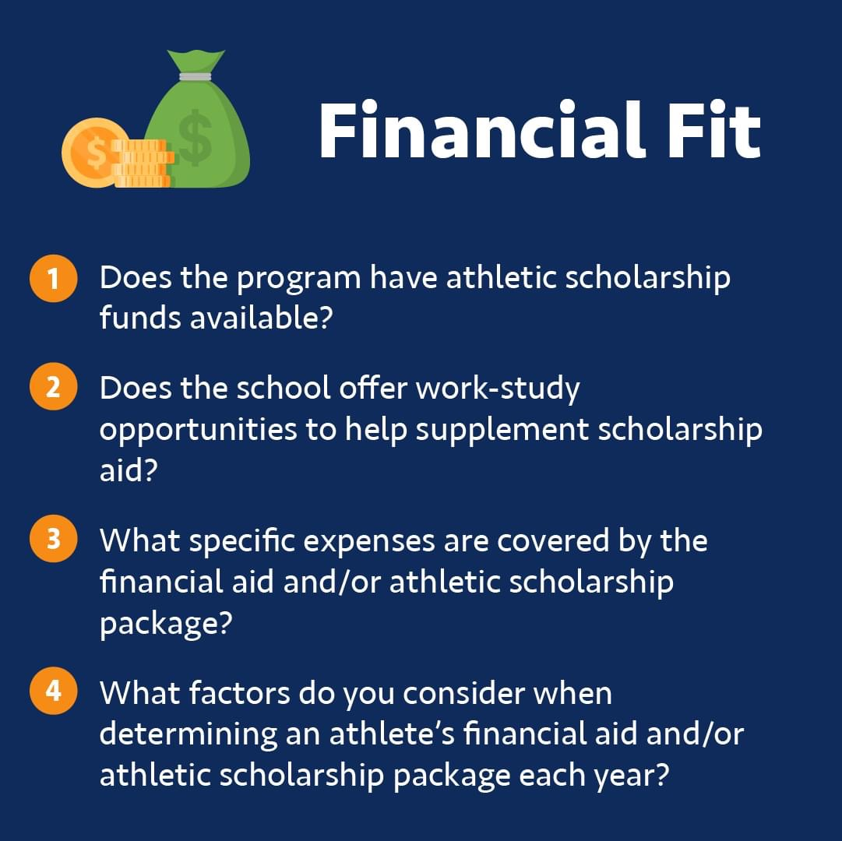
financial aid

Slide 11
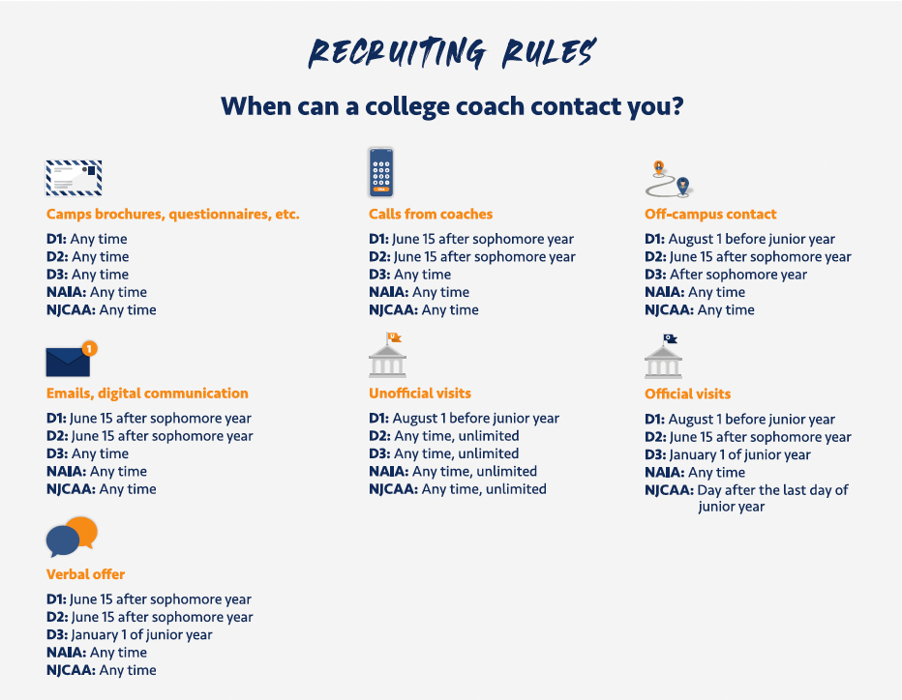

Slide 12
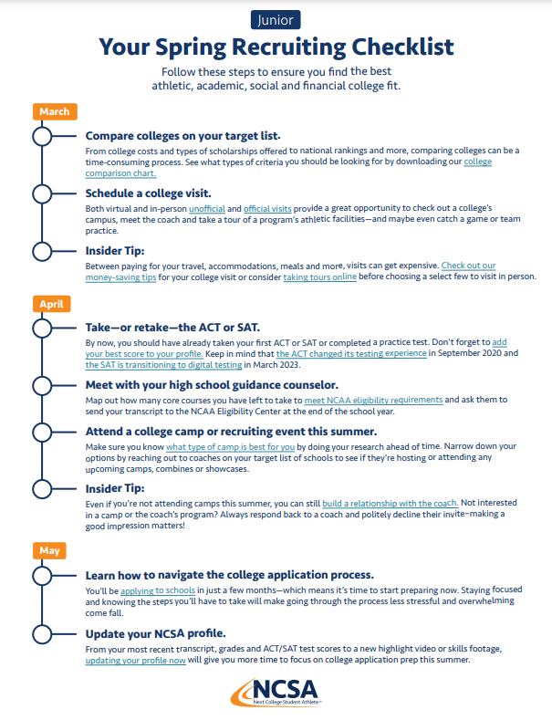
RECRUITING CHECKLISTS
NCSA has a recruiting checklist for every “Season” and for every grad year!
Fall, Winter, Spring & Summer
Freshman, Sophomore, Junior & Senior
https://www.ncsasports.org/recruiting/managing-recruiting-process/spring-checklist

Slide 13
Recruiting Tips for M.A.P. College ID Clinic

Slide 14
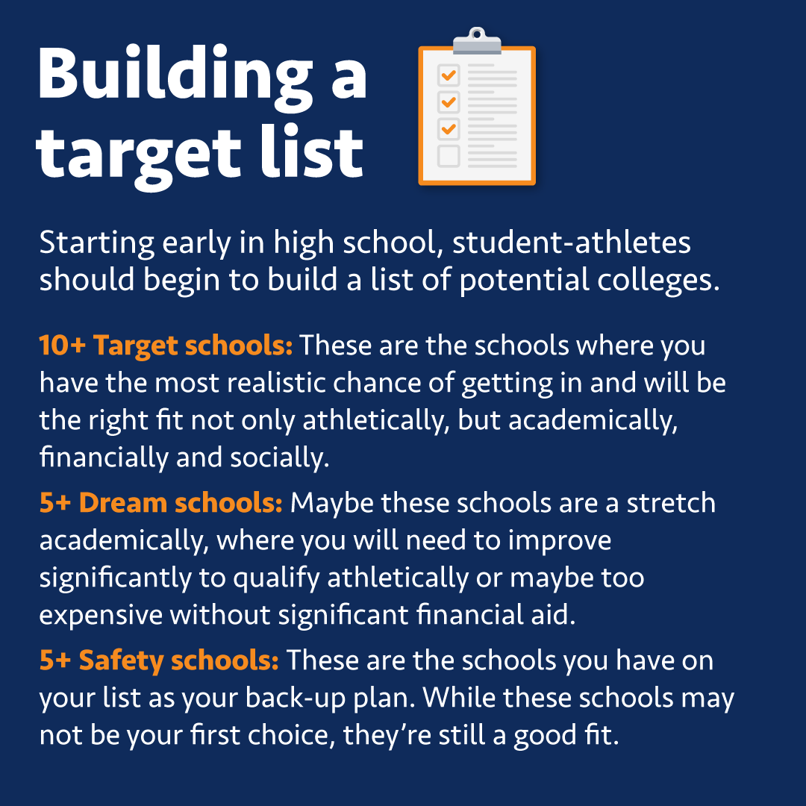
BEFORE COLLEGE ID CLINIC
Make or Update your Target List
Location, Academics, Size of School
Division Level, Coach Communication/Interest
Research Confirmed College Coaches
Make note of something relatable / unique about them or their program
You’ll use this info later!
Update your Online Profile

Slide 15
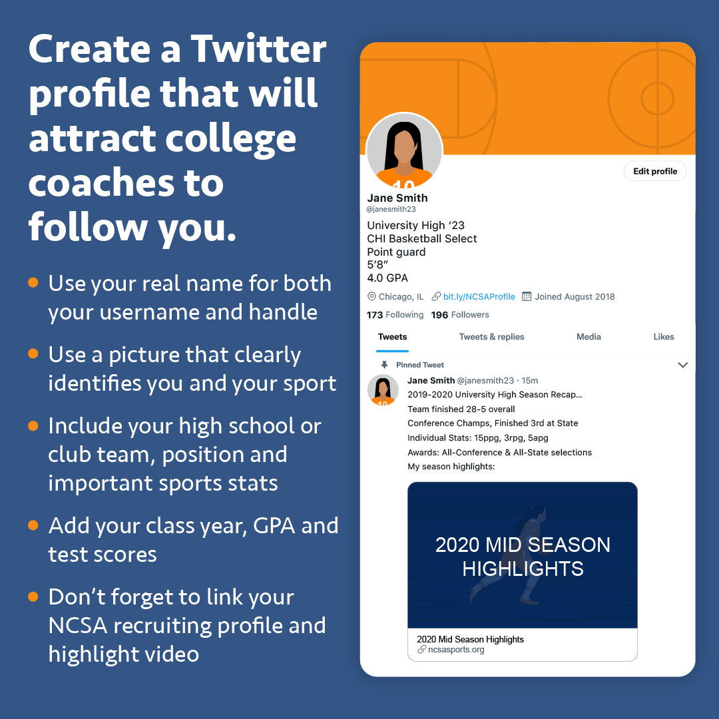
Online PROFILE = “Resume”
ACADEMICS
Report Card / Transcript
ACT / SAT Score or Test Date
Updated GPA / Class Rank
Intended Major(s) / Interests
Extracurricular Activities
Honor AP Classes / Awards
ATHLETICS
HS Season / Awards
Club Team / Schedule
Update Coach’s Name
Jersey Number
Highlight Video
Key Stats

Slide 16
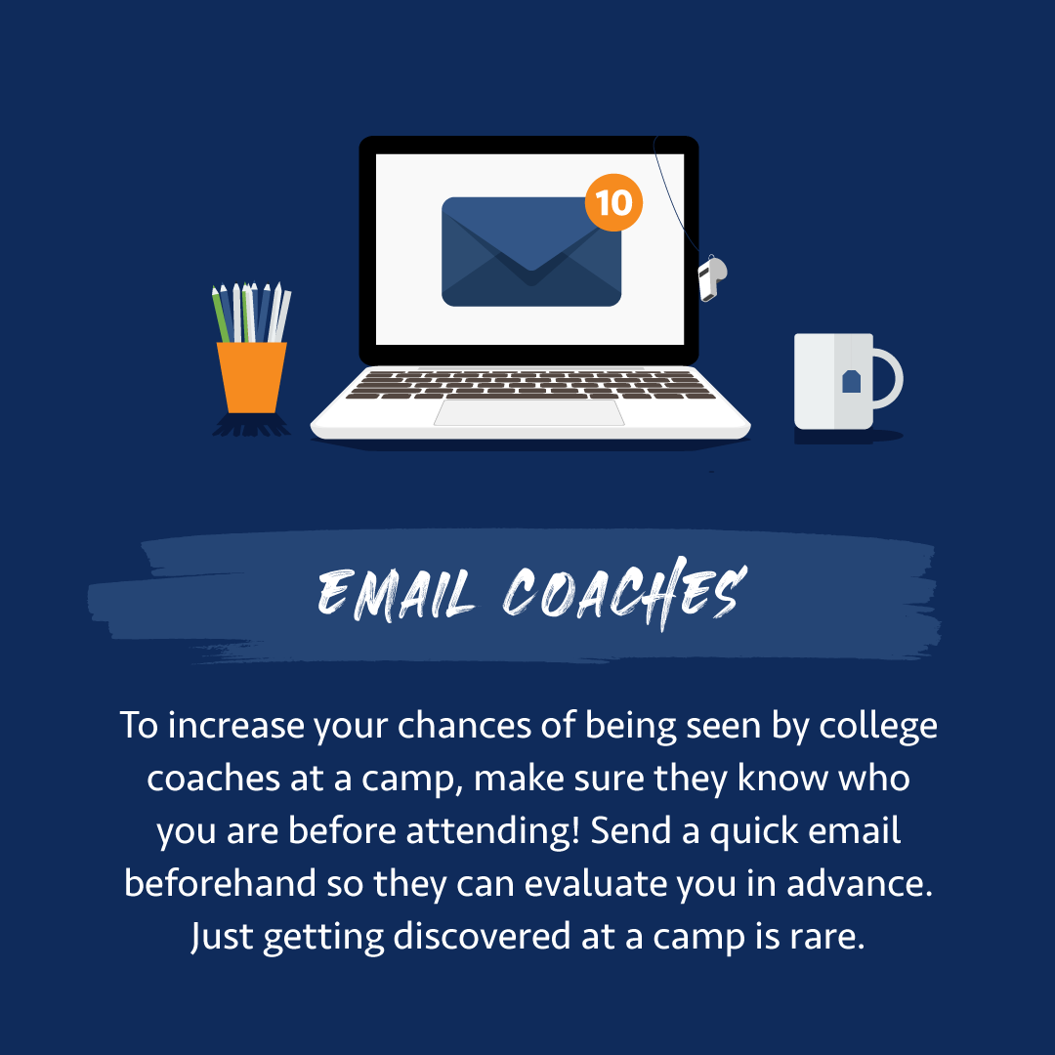
BEFORE COLLEGE ID CLINIC
Send an Intro / Update Email Coaches
Subject Line: M.A.P. College ID Clinic / Name / Grad Year / Position / VIDEO
Body of Email: Who, What, When, Where Why and How
Why you are looking forward to the showcase
Why you are interested in that coach’s program
Use that research you did earlier!
How they can find more information
Example: Include NCSA Profile Link or Highlight Video link
Start the communication process
For More Email Ideas:
https://www.ncsasports.org/recruiting/contacting-college-coaches/email

Slide 17
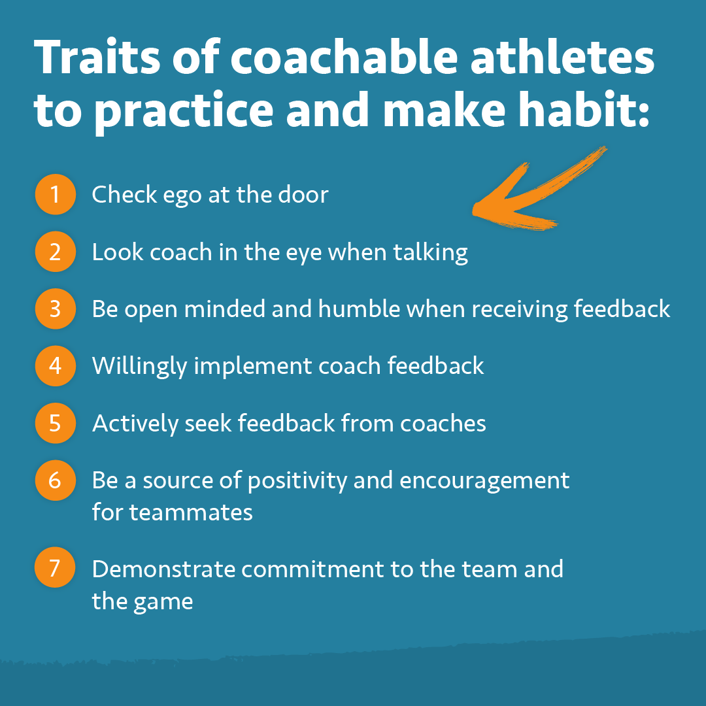
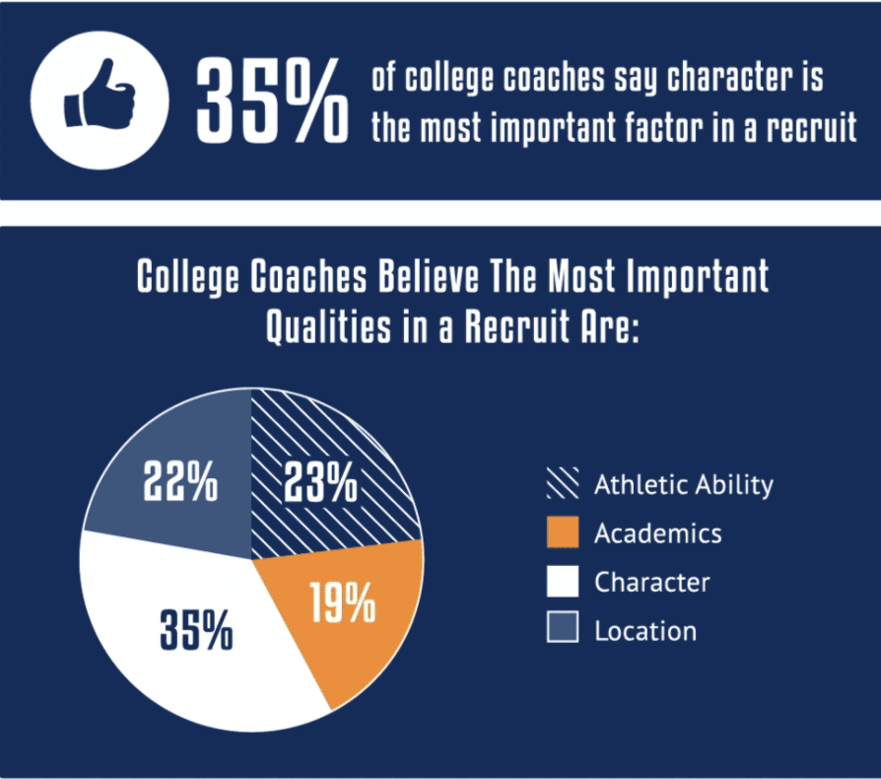
DURING COLLEGE ID CLINIC
Your talent will get you noticed, but your character will get you recruited
Things that require ZERO talent
Help, cheer for and encourage your teammates
Hustle, effort, attitude, energy
Be coachable. Be prepared.
HAVE FUN!

Slide 18
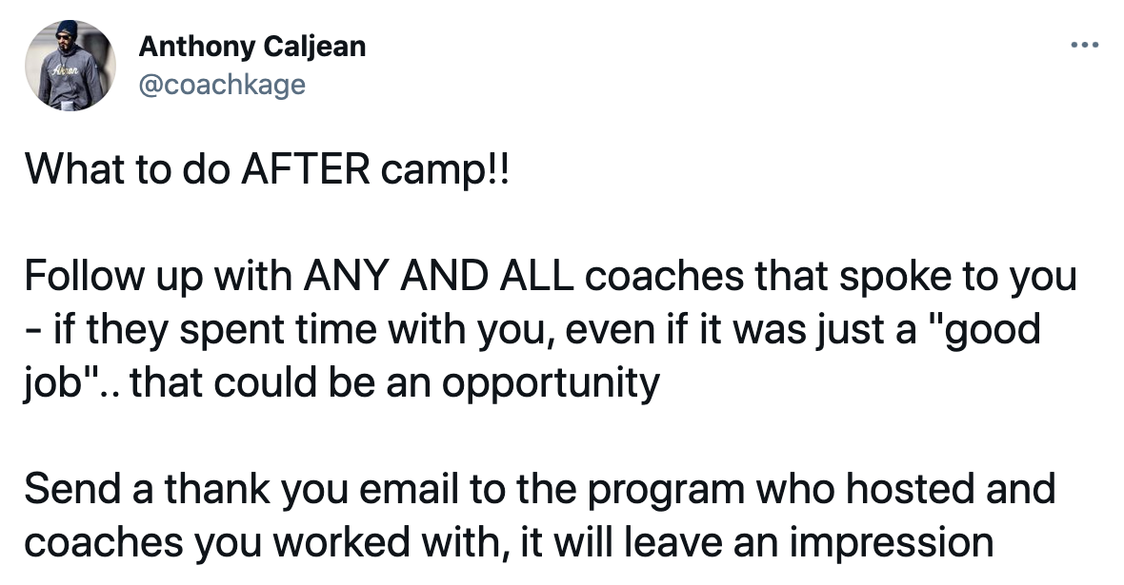
AFTER THE COLLEGE ID CLINIC
Send College Coaches on your Target List a Follow Up / Thank You Email
Thank them if you know they watched you play
Let them know how tournament went, what is next for you and what you are working
upcoming events, updated highlight video, vacation, new class at school
Keep building the relationship & continuing the communication
Ask follow up questions!
Feedback after viewing film?
Can you setup a phone call & campus visit?
Update your Online Profile
NCSA Profile – EDIT PROFILE – VIDEO
Social Media or Club Team Page

Slide 19
NCSA Recruiting Resources

Slide 20
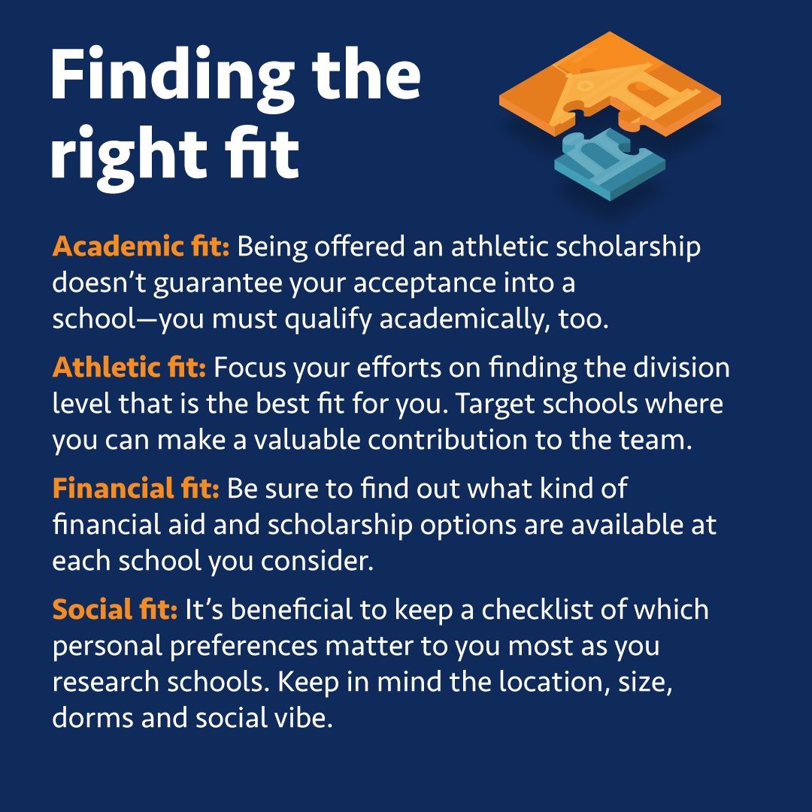
Getting started
Think about your Preferences
Academics, Athletics, Financial, Social Fit
Make a Target List of Schools (50-60)
Dream (10) - Target (25) - Safety (10)
+ Programs at your Showcases, Camps, or Tournaments
+ Coaches who have contacted you or your coach
+ NCSA Profile Views, Follows, Roster Openings

Slide 21
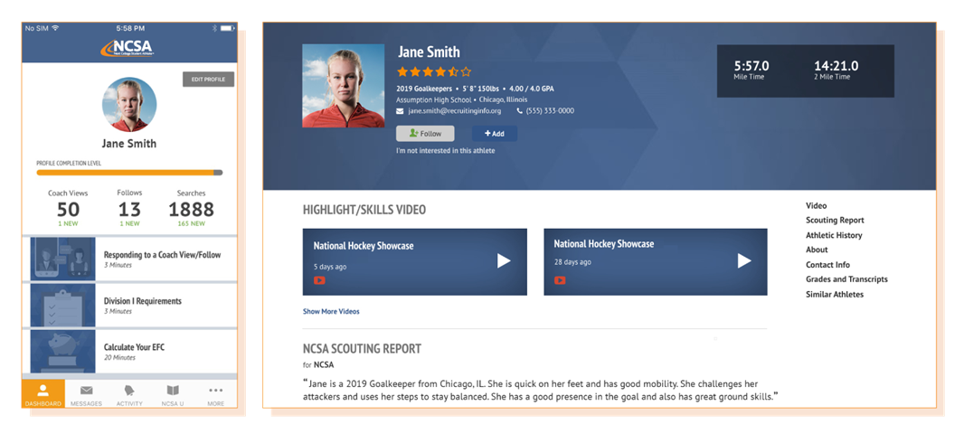
START AN ONLINE PROFILE

Slide 22
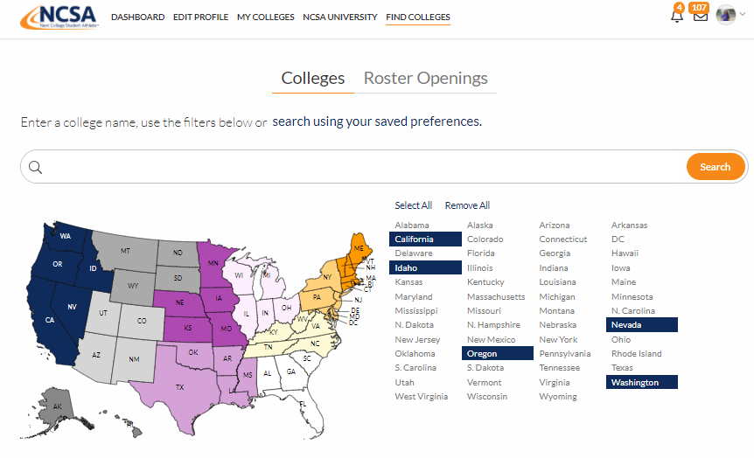
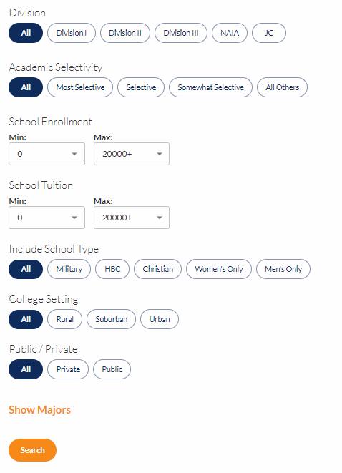
RESEARCH SCHOOLS

Slide 23
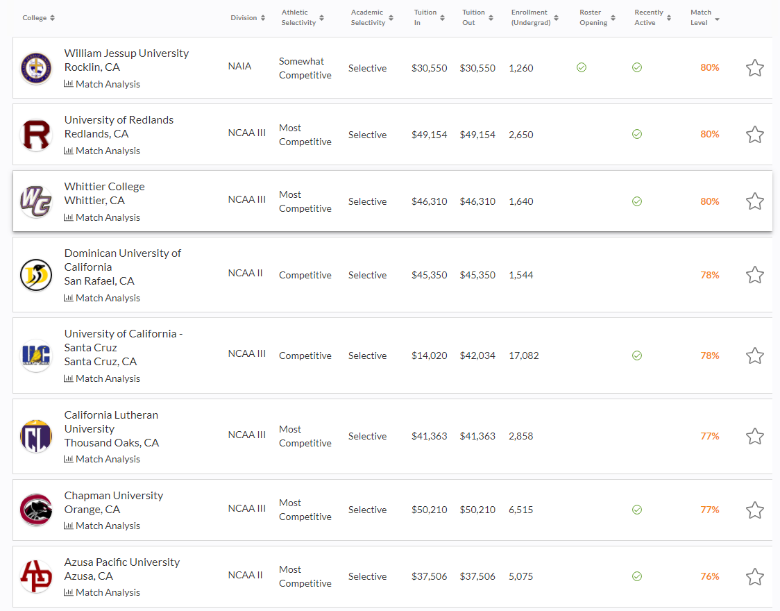
SEARCH RESULTS
NCSA Free Profile
Search Feature Available!
NCSA Membership Provides
Match Level
Your Preferences, ACT/SAT, GPA
College Coach's Needs
NCSA Video Evaluation
Viewed by an NCSA Soccer Recruiting Coach
Connect
College Coach Email Database

Slide 24
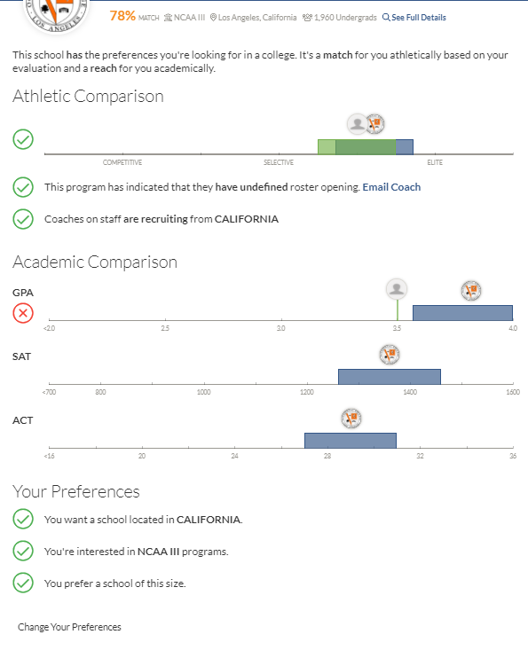
Match Analysis
Helps you find your right fit!

Slide 25
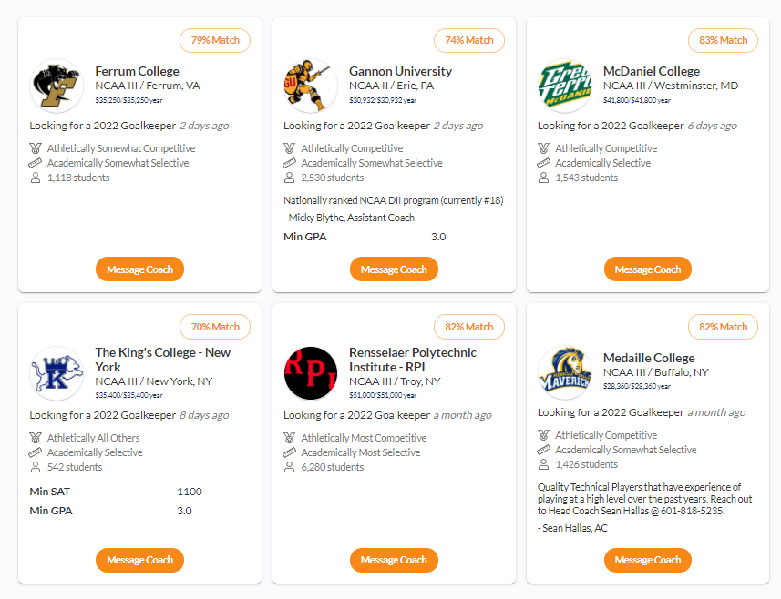
ROSTER OPENINGS
TO SCHEDULE YOUR FREE
NCSA RECRUITING CALL
SCAN HERE:

Slide 27
NEXT STEPS
Schedule Your Free Assessment I Activate Your Profile
NCSA Representative will contact you to schedule this 30-45-minute call designed to discuss:
Are you ready to start the recruiting process?
Current recruiting progress and journey
Next steps and going over NCSA Profile Resources
Activating your Free Profile to be searchable to College Coaches
INTERACTIVE session with both parent and athlete over the computer.

Slide 28
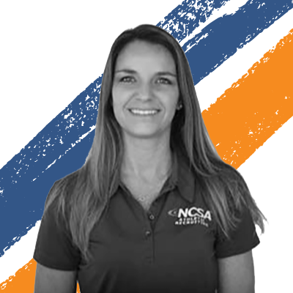
QUESTIONS?
SCAN CODE to set up your RECRUITING CALL
FOLLOW @NCSASoccer on social media
CONTACT us with any questions!
Coach Sue’s Email: suewebber@ncsasports.org
Coach Luis’s Email: coachlcortell@ncsasports.org

